Slide 1
ENEL 419
Mathematical Expectations of Continuous Random Variables
Reading Exercise: Montgomery and Runger Sections 4.3
Yates Section 4.4

Slide 2
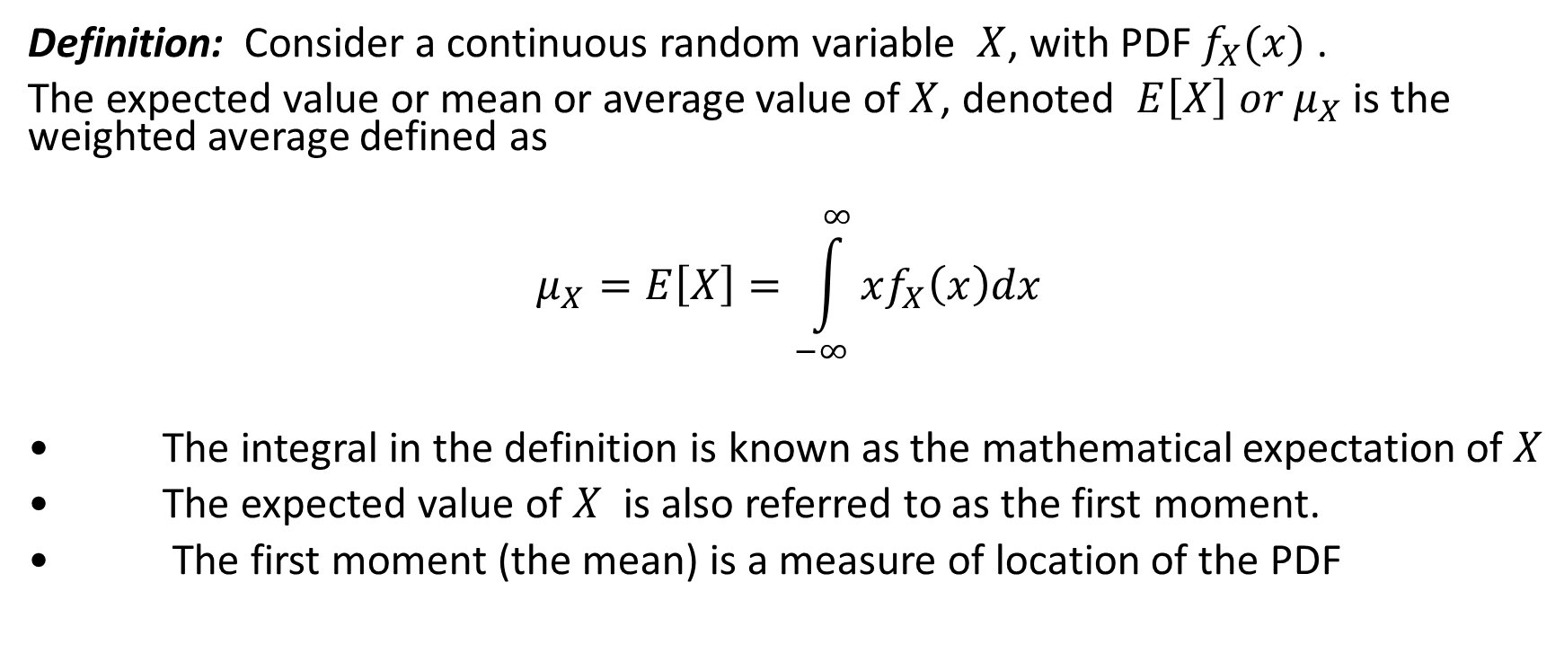
Mathematical Expectations (Expected value of Mean value)
Definition: Consider a continuous random variable $X$, with PDF $f_{X}(x)$ .
The expected value or mean or average value of $X$, denoted $E\left[X\right] or μ_{X}$ is the weighted average defined as
$$μ_{X}=E\left[X\right]=\int_{−∞}^{∞}{xf_{X}\left(x\right)dx}$$
• The integral in the definition is known as the mathematical expectation of $X$
• The expected value of $X$ is also referred to as the first moment.
• The first moment (the mean) is a measure of location of the PDF

Slide 3
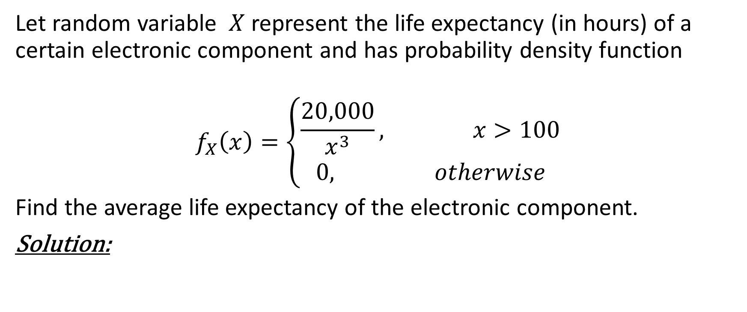
Mathematical Expectations Example 1
Let random variable $X$ represent the life expectancy (in hours) of a certain electronic component and has probability density function
$$f_{X}\left(x\right)=\left\{\begin{aligned}\frac{20,000}{x^{3}}, x>100 \\ &0, otherwise\end{aligned}\right.$$
Find the average life expectancy of the electronic component.
Solution:

Slide 4
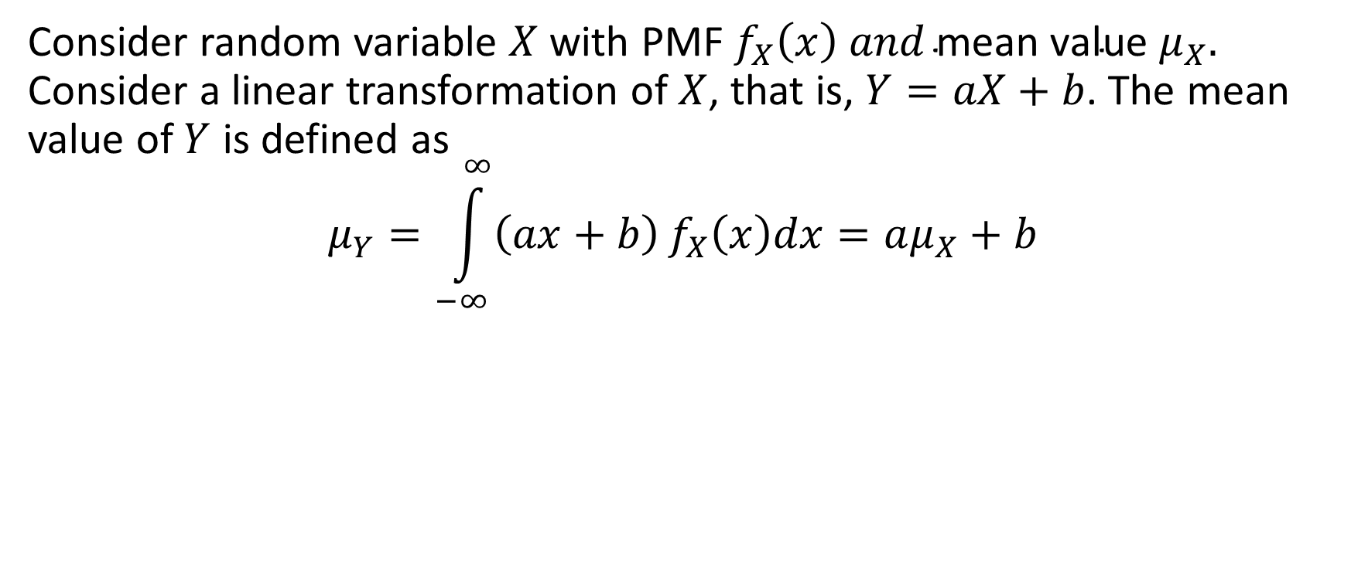
Linearity Property of the Mathematical Expectation
Consider random variable $X$ with PMF $f_{X}\left(x\right) and \text{mean} \text{value} μ_{X}.$ Consider a linear transformation of $X$, that is, $Y=aX+b$. The mean value of $Y$ is defined as
$$μ_{Y}=\int_{−∞}^{∞}{\left(ax+b\right)}f_{X}\left(x\right)dx=aμ_{X}+b$$

Slide 5

Example 2
Consider continuous random variable $X$ with PDF
$$f_{X}\left(x\right)=\left\{\begin{aligned}\frac{x^{2}}{3}, −1≤x≤2 \\ &0, otherwise\end{aligned}\right.$$
Find the mean of $Y=4X−3$.
Solution:
$$μ_{Y}=4μ_{X}−3$$
$$μ_{X}=\int_{−1}^{2}{x\frac{x^{2}}{3}dx}=\frac{1}{12}{\left.x^{4}\right|}_{−1}^{2}=\frac{15}{12}=\frac{5}{4}⇒μ_{Y}=2$$

Slide 6
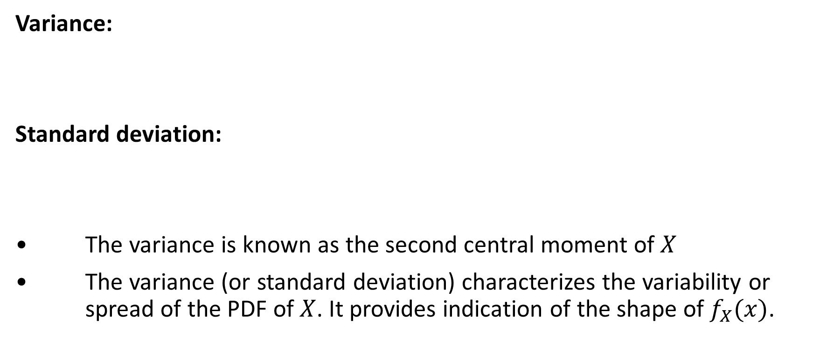
Variance and Standard Deviation of Continuous Random Variables
Variance:
Standard deviation:
• The variance is known as the second central moment of $X$
• The variance (or standard deviation) characterizes the variability or spread of the PDF of $X$. It provides indication of the shape of $f_{X}(x)$.

Slide 7
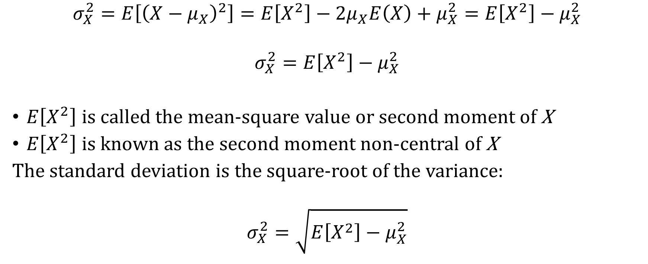
Shortcut formula for the Variance
$$σ_{X}^{2}=E\left[{\left(X−μ_{X}\right)}^{2}\right]=E\left[X^{2}\right]−{2μ}_{X}E\left(X\right)+μ_{X}^{2}=E\left[X^{2}\right]−μ_{X}^{2}$$
$$σ_{X}^{2}=E\left[X^{2}\right]−μ_{X}^{2}$$
$E\left[X^{2}\right]$ is called the mean-square value or second moment of X
$E\left[X^{2}\right]$ is known as the second moment non-central of X
The standard deviation is the square-root of the variance:
$$σ_{X}^{2}=\sqrt{E\left[X^{2}\right]−μ_{X}^{2}}$$

Slide 8
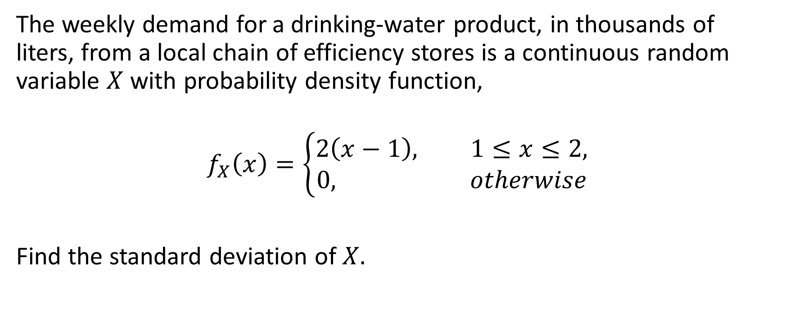
Example 3
The weekly demand for a drinking-water product, in thousands of liters, from a local chain of efficiency stores is a continuous random variable $X$ with probability density function,
$$f_{X}\left(x\right)=\left\{\begin{aligned}2\left(x−1\right)&, 1≤x≤2, \\ 0, otherwise\end{aligned}\right.$$
Find the standard deviation of $X.$

Slide 9

Example 3 Solution
$$μ_{X}=2\int_{1}^{2}{x\left(x−1\right)dx}=\frac{5}{3}$$
$$E\left[X^{2}\right]=2\int_{1}^{2}{x^{2}\left(x−1\right)dx=\frac{17}{6}}$$
$$σ_{X}^{2}=E\left[X^{2}\right]−μ_{X}^{2}=\frac{17}{6}−{\left(\frac{5}{3}\right)}^{2}=\frac{1}{18}$$
$$σ_{X}=\frac{1}{3\sqrt{2}}$$

Slide 10

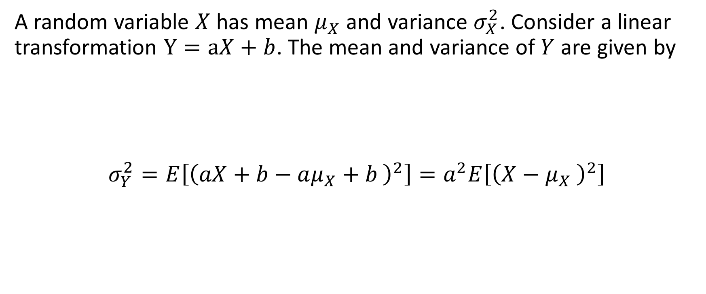
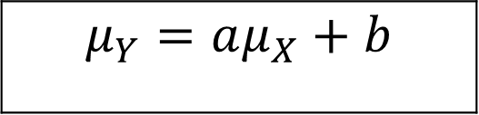
Linear Transforms of Continuous Random Variables
A random variable $X$ has mean $μ_{X}$ and variance $σ_{X}^{2}$. Consider a linear transformation $Y=aX+b$. The mean and variance of $Y$ are given by
$$σ_{Y}^{2}=E\left[{\left(aX+b−aμ_{X}+b \right)}^{2}\right]=a^{2}E\left[{\left(X−μ_{X} \right)}^{2}\right]$$
$$μ_{Y}=aμ_{X}+b$$
$$σ_{Y}^{2}={a^{2}σ}_{X}^{2}$$

Slide 11

Example 4
A random variable $X$ has PDF given by
$$f_{X}\left(x\right)=\left\{\begin{aligned}\frac{x^{2}}{3}, −1≤x≤2, \\ &0, otherwise.\end{aligned}\right.$$
Find the variance of $h\left(X\right)=4X+3$

Slide 12
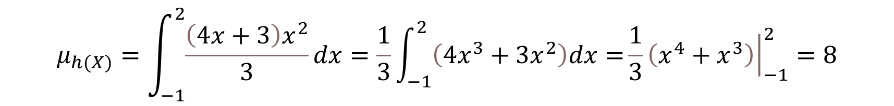

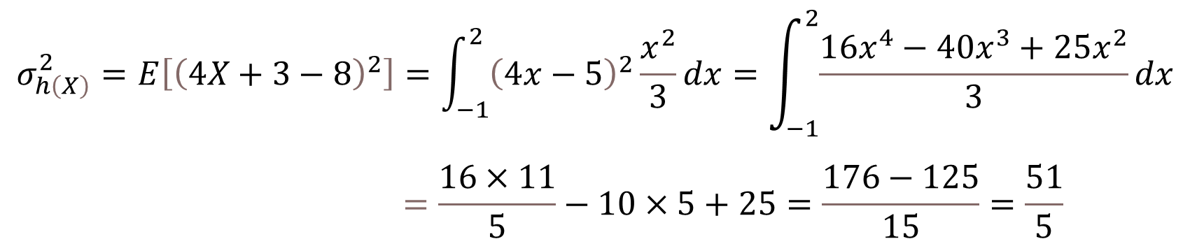
Example 4 Solutions
Approach 1: Use formula $σ_{h(X)}^{2}=E\left[{\left(h(X)−μ_{h(X)}\right)}^{2}\right]$
$$μ_{h(X)}=\int_{−1}^{2}{\frac{\left(4x+3\right)x^{2}}{3}}dx=\frac{1}{3}\int_{−1}^{2}{\left(4x^{3}+3x^{2}\right)dx=}\frac{1}{3}{\left.\left(x^{4}+x^{3}\right)\right|}_{−1}^{2}=8$$
$$\begin{matrix}\begin{aligned}σ_{h\left(X\right)}^{2}=E\left[{\left(4X+3−8\right)}^{2}\right]=\int_{−1}^{2}{{\left(4x−5\right)}^{2}}\frac{x^{2}}{3}dx=\int_{−1}^{2}{\frac{16x^{4}−40x^{3}+25x^{2}}{3}}dx \\ \end{aligned} \\ \end{matrix}$$
$$=\frac{16×11}{5}−10×5+25=\frac{176−125}{15}=\frac{51}{5}$$

Slide 13

Variance of Linear Transforms of Continuous Random Variables
Approach 2: Use formula ${σ_{h(X)}^{2}=a^{2}σ}_{X}^{2}$
$$μ_{X}=\int_{−1}^{2}{x\frac{x^{2}}{3}dx=}\frac{5}{4}, E\left[X^{2}\right]=\int_{−1}^{2}{x^{2}\frac{x^{2}}{3}dx=\frac{11}{5}}$$
$$σ_{X}^{2}=E\left[X^{2}\right]−μ_{X}^{2}=\frac{11}{5}−\frac{25}{16}=\frac{51}{80}$$
$$σ_{h(X)}^{2}=16σ_{X}^{2}=16×\frac{51}{80}=\frac{51}{5}$$

Slide 14
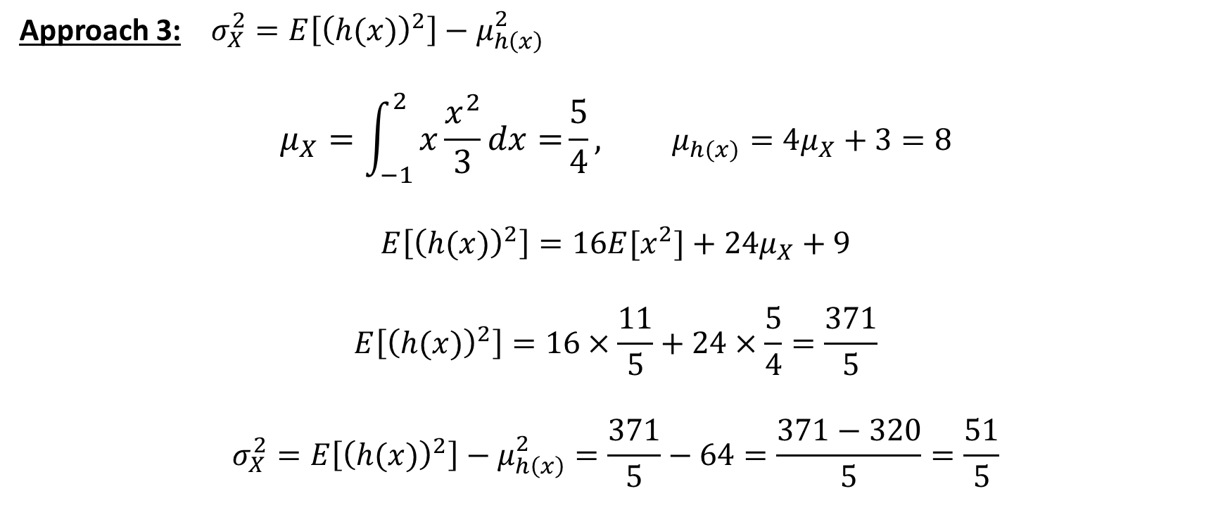
Variance of Linear Transforms of Continuous Random Variables
Approach 3: $σ_{X}^{2}=E\left[{\left(h(x)\right)}^{2}\right]−μ_{h\left(x\right)}^{2}$
$$μ_{X}=\int_{−1}^{2}{x\frac{x^{2}}{3}dx=}\frac{5}{4}, μ_{h(x)}=4μ_{X}+3=8$$
$$E\left[{\left(h(x)\right)}^{2}\right]=16E[x^{2}]+24μ_{X}+9$$
$$E\left[{\left(h(x)\right)}^{2}\right]=16×\frac{11}{5}+24×\frac{5}{4}=\frac{371}{5}$$
$$σ_{X}^{2}=E\left[{\left(h(x)\right)}^{2}\right]−μ_{h\left(x\right)}^{2}=\frac{371}{5}−64=\frac{371−320}{5}=\frac{51}{5}$$

Slide 15
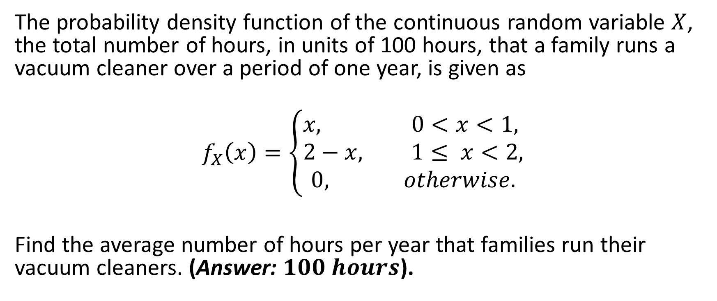
Example 5
The probability density function of the continuous random variable $X$, the total number of hours, in units of 100 hours, that a family runs a vacuum cleaner over a period of one year, is given as
$$f_{X}\left(x\right)=\left\{\begin{aligned}&x, 0<x<1, \\ &2−x, 1≤ x<2, \\ 0, otherwise.\end{aligned}\right.$$
Find the average number of hours per year that families run their vacuum cleaners. (Answer: $100 hours$).

Slide 16
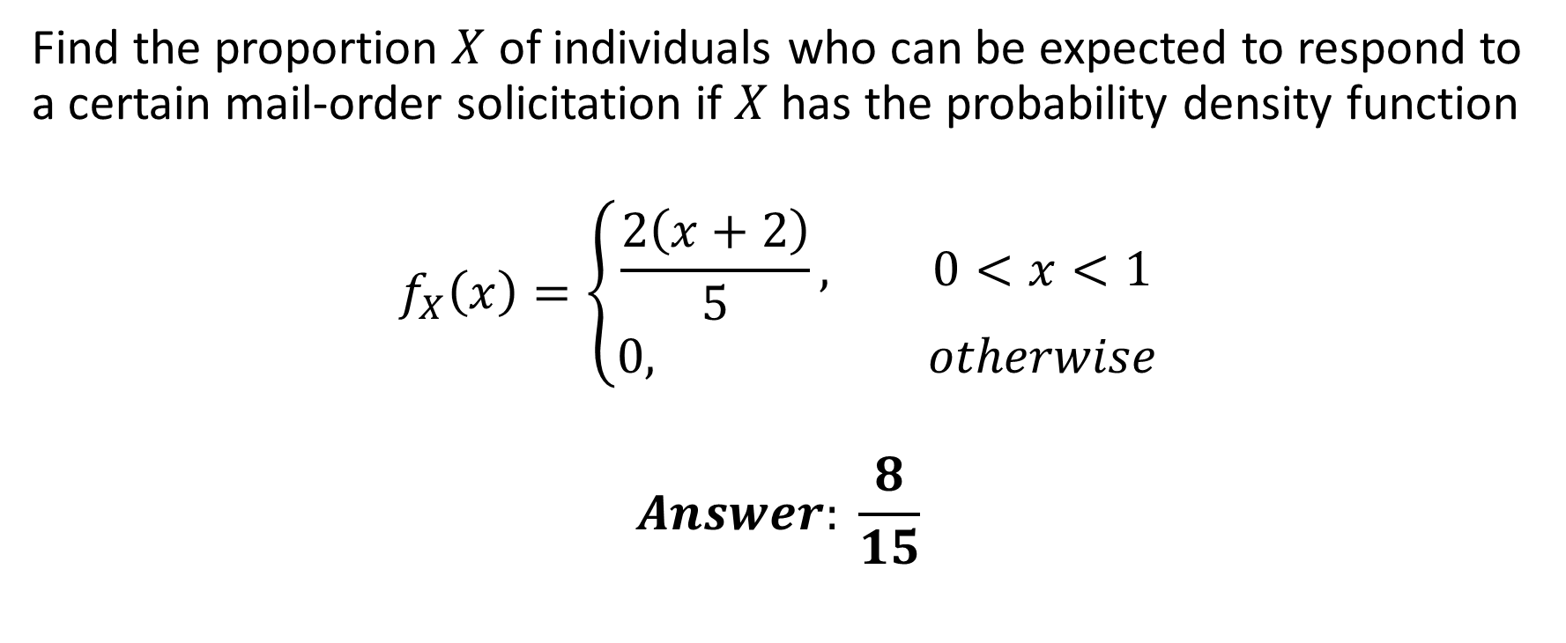
Example 6
Find the proportion $X$ of individuals who can be expected to respond to a certain mail-order solicitation if $X$ has the probability density function
$$f_{X}\left(x\right)=\left\{\begin{aligned}\frac{2\left(x+2\right)}{5}&, 0<x<1 \\ 0, otherwise\end{aligned}\right.$$
$$Answer: \frac{8}{15}$$

Slide 17
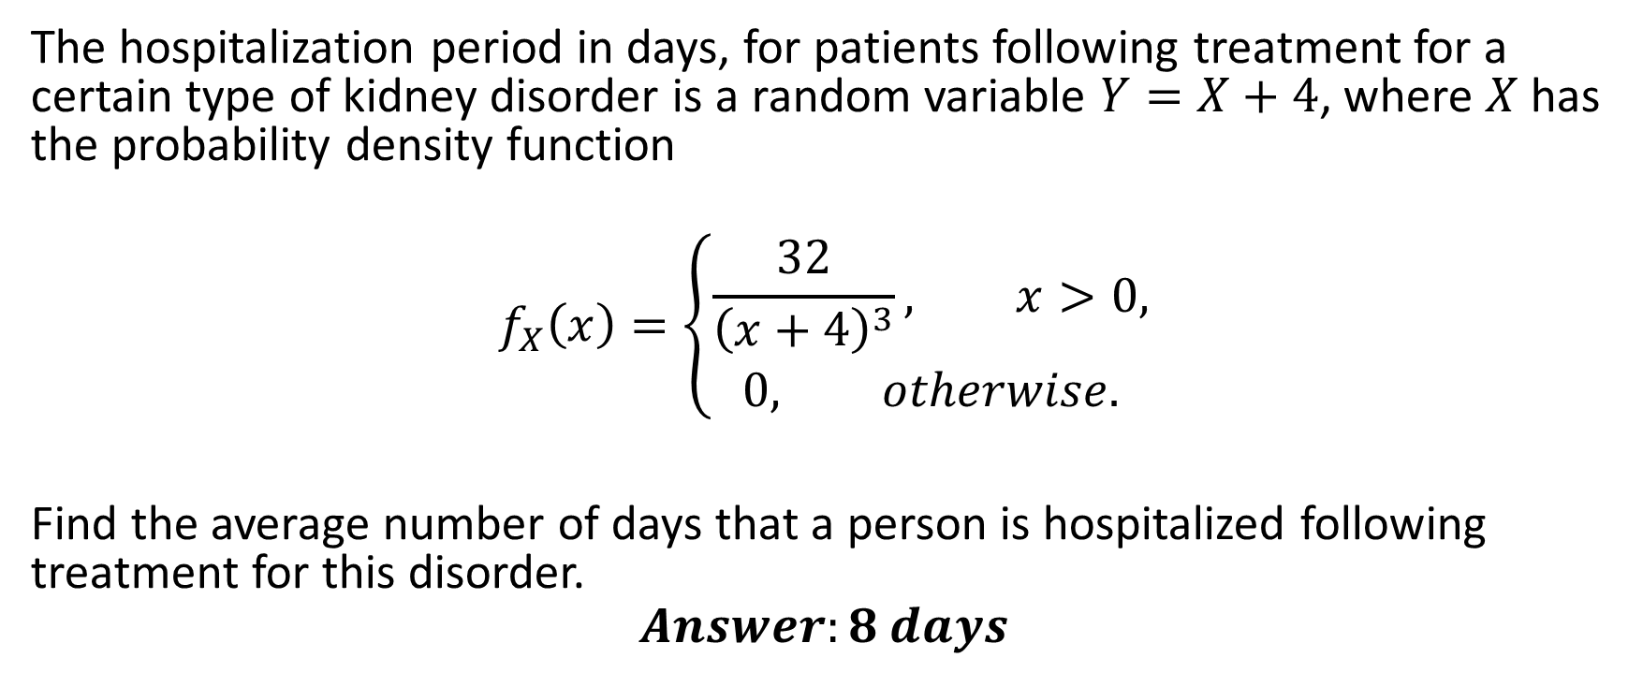
Example 7
The hospitalization period in days, for patients following treatment for a certain type of kidney disorder is a random variable $Y=X+4$, where $X$ has the probability density function
$$f_{X}\left(x\right)=\left\{\begin{aligned}\frac{32}{{\left(x+4\right)}^{3}}, x>0, \\ &0, otherwise.\end{aligned}\right.$$
Find the average number of days that a person is hospitalized following treatment for this disorder.
$$Answer:8 days$$

